Slide 1
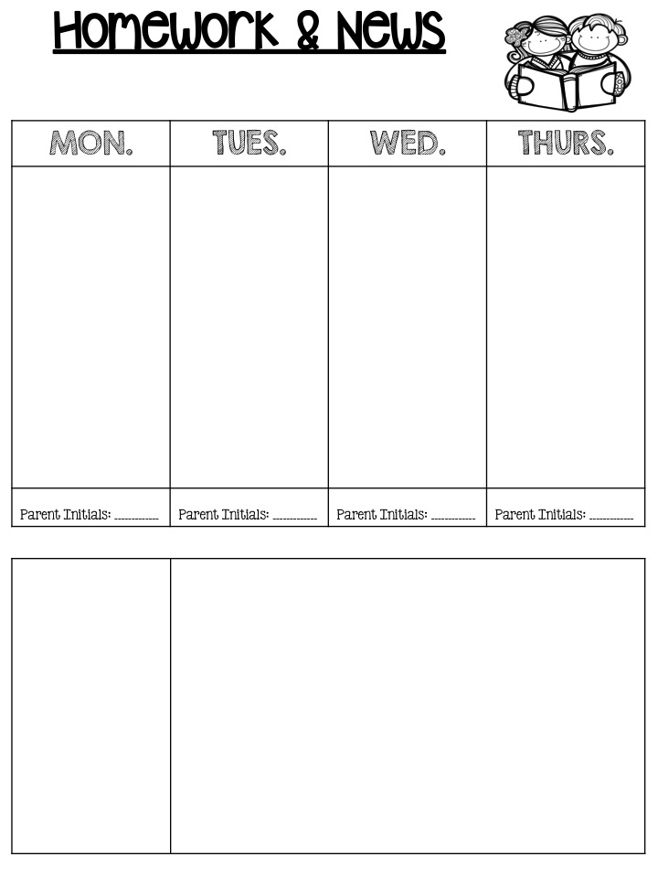
Miss Horgan’s First Grade
September 25-29, 2023
Religion: Review and Study for test.
Math: Worksheet
Reading: KISI page 4
Spelling: Write words 1x for day 1 on worksheet
Religion: Study for test on Thursday.
Math: worksheet
Reading: KISI page 9
Spelling: Write words 1x for day 2
Religion: Study for the Chapter 1 test tomorrow!
7:00 pm- 40 Hours Devotion
Reading: Words about writing worksheet
Spelling: Write words 1x for day 4 AND Study for test tomorrow!
Read sight words every night!
Tests this Week
Thursday
Religion
Friday
Spelling
Reading
Notes and Reminders
GYM IS TUESDAY THIS WEEK!
Please have your child’s books covered in contact paper by Monday, October 2.
Please ensure your child is in their complete uniform daily.
Studying is an important part of your child’s homework. Please help them study so they are prepared for their tests.

